Slide 1

DRIVER MONITORING SYSTEM
BIPIN KUMAR SONI (16P31A1203)
APPASANI LAVANYA (16P31A1201)
B.K.SRIKAR (16P31A1202)
M.SIRI CHANDANA (16P31A1224)
Under the guidance of:
A.MOHAN,M.Tech,
ASSISTANT PROFESSOR,
IT Department.

Slide 2
INTRODUCTION
Aim of this project is implementing the system as a prototype by capturing the live images of the eyes and fed them in to the Microcontroller in which the software is used to process the video and convert it in to frames and process it accordingly. Some customized algorithms are coded for image segmentation of eyes from the entire image and image recognition of the eyes and face position.
On the whole, by sensing the eye blinks we can decide if the eye blinks are more than the driver is very sleepy, Drinking and it will automatically turn off the vehicle, if the driver is showing the left eye ball position than the left indicator of the car is turned on and so on.

Slide 3
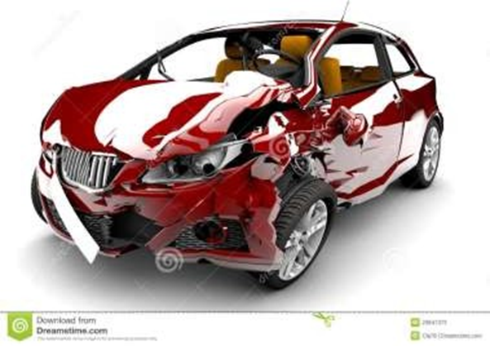
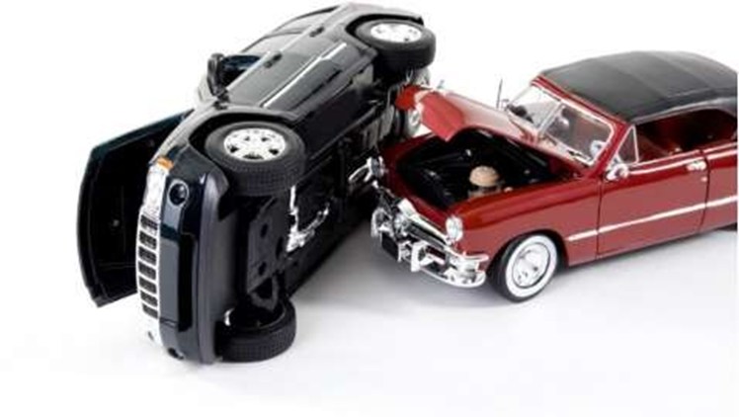
SCOPE OF THE SYSTEM
Nowadays the driver safety in the car is one of the most wanted system to avoid accidents. Our objective of the project is to ensure the safety system. For enhancing the safety, we are detecting the eye blinks of the driver and estimating the driver status and control the car accordingly.

Slide 4
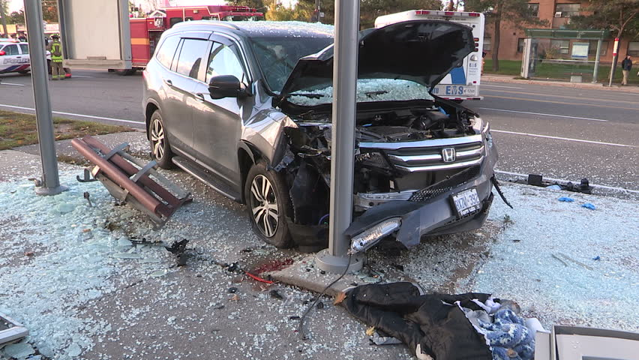
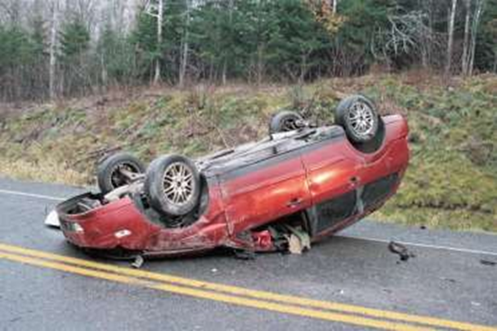
EXISTING SYSTEM
According to a survey in 2015, It was found that 37% of the accidents are caused due to drowsy driving.
The present situation of the drivers is not trust worthy. There is no system to monitor the behavior and performance of the person who is driving a car, bus, heavy vehicle etc.

Slide 5
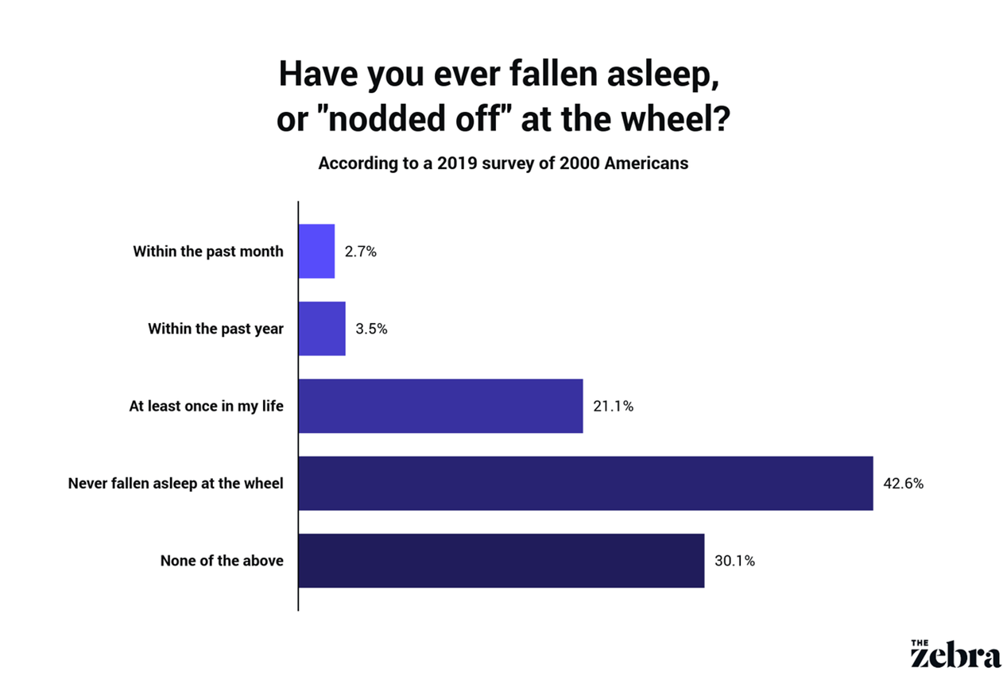

Slide 6
PROPOSED SYSTEM
The main principle of the proposed system is using OpenCV(Open Source of Computer Vision) library which is based on real time facial images analysis for warning the driver of drowsiness or in attention to prevent the traffic accidents.
The facial images of driver are taken by a camera which is installed. An algorithm and an inference are proposed to determine the level of fatigue by measuring the eye blinking duration and face detection to track the eyes, and warn the driver accordingly.

Slide 7
If the eyes are found closed for 5 to 8 consecutive frames, The system draws the conclusion that the driver is falling asleep and issues a warning signal. This system is also able to detect when the eyes cannot be found.
If the alarm sound is not reached to the driver then it calculates the ear threshold value if it is less than 0.3 it sends the alarm otherwise it vibrates the seat of the driver and increase the volume of the alarm.

Slide 8
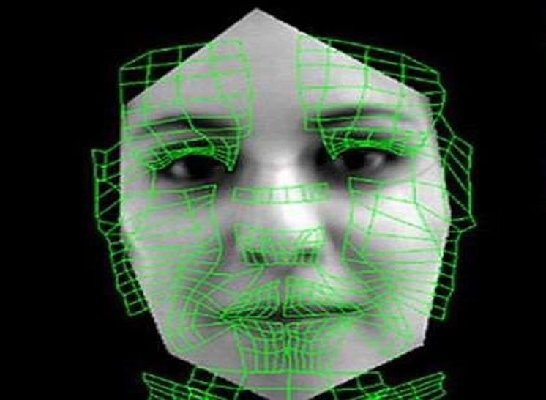
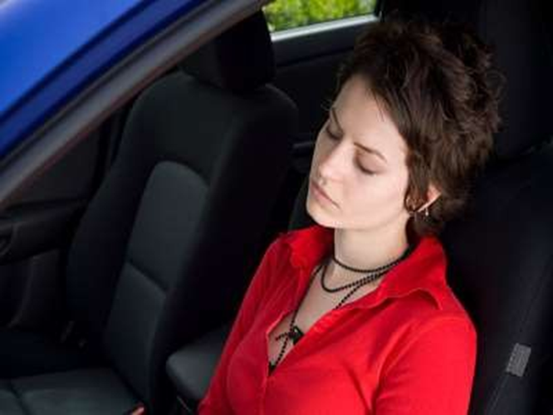
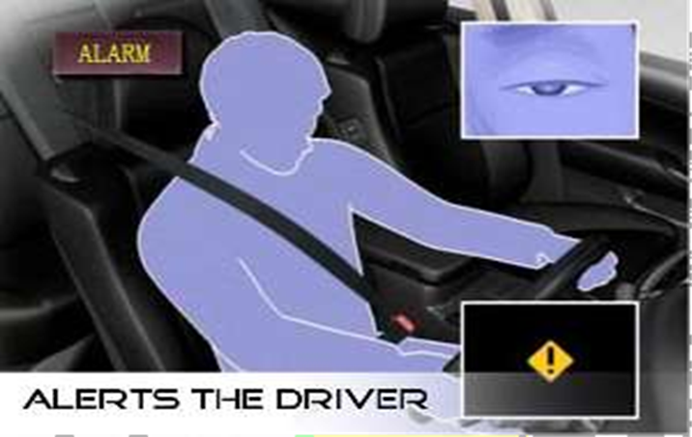

Slide 9
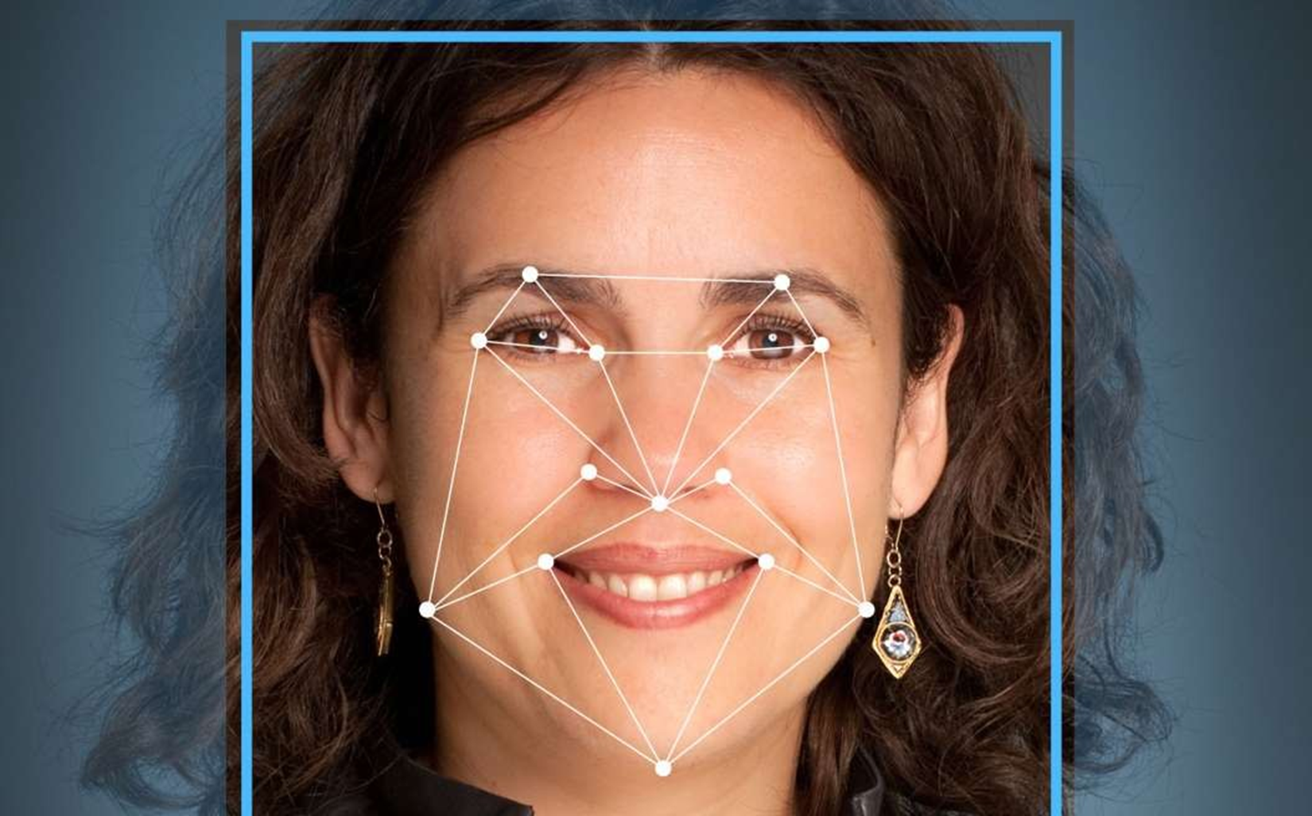

Slide 10
USER INTERFACE
The project is based on the open CV.
The system requires the raspberry Pi and a webcam as an interface for the user.The camera will detect the face and its features and base on the algorithm.It will be buzzering the alarm.

Slide 11
FUNCTIONAL REQUIREMENTS
RaspberryPi
Camera
Sensors

Slide 12
SOFTWARE REQUIREMENTS
Raspbian(OS)
Python
Open CV(module)
Numpy
Imutlis
Dlib

Slide 13
HARDWARE REQUIREMENTS
Raspeberry Pi
A Micro Controller
Camera
Alarm/Vibrator
Relay

Slide 14
USABILITY
Can be used in buses.
Can be used in cars.
Can be used in trains.
Can also be used in aeroplanes.

Slide 15
RELIABILITY
On-device(car, bus).
Real time monitoring.

Slide 16
PERFORMANCE
No loss of company assets.
Valuable lives will be saved.
Decrease in accidents due to drowsiness.

Slide 17
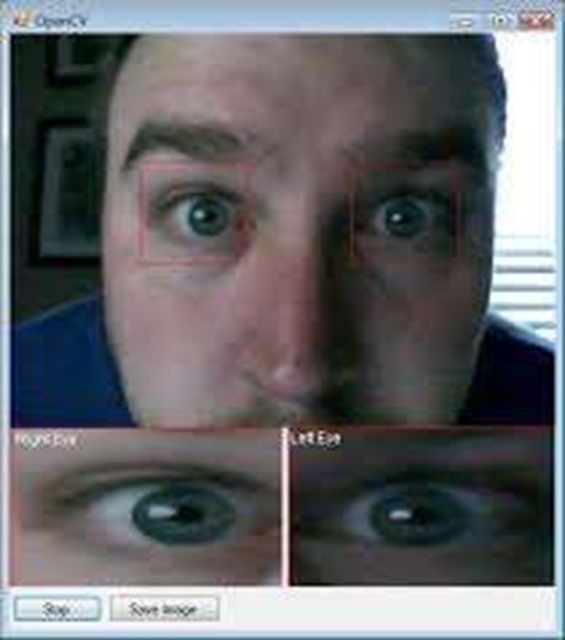
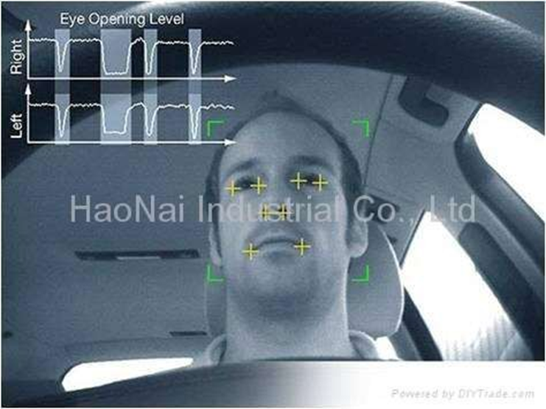
PHYSICAL ENVIRONMENT

Slide 18


